Slide 1
OptionPayOffer
A tool for option trading
April 24 2019
Chenxi Xiang
186003830
Peiwen Zhang
174009097
Tianyi Ji
190003115

Slide 2
CONTENTS
1
Overview
2
Performance
What our project goes for
Project Show
3
Logic & Code Design
4
Backlog
Why we design like this
Some future improvement

Slide 3
Overview
What our project goes for
A tool to estimate the different spot-based curves of vanilla portfolios.
Pricing is dvailable for vanilla options based on Black-Scholes or Monte-Carlo methods.
Only vanilla option is available (barrier is not supported)
Can estimate option payoff under different level of spot
Can evaluate option price under different market using different evaluation engine

Slide 4
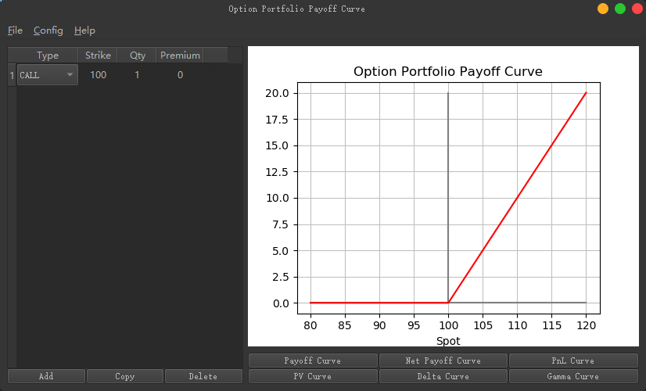

Slide 5
Performance
Project Show
Our Program design of traders, by traders and for traders

Slide 6
Logic & Code Design
Why we design like this

Slide 7
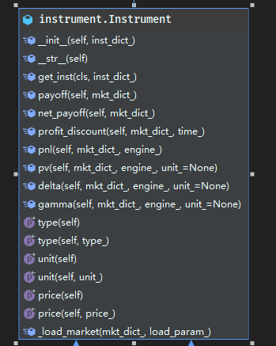
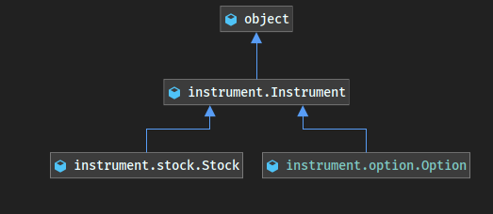
Data Structure
Basic Data Classes

Slide 8
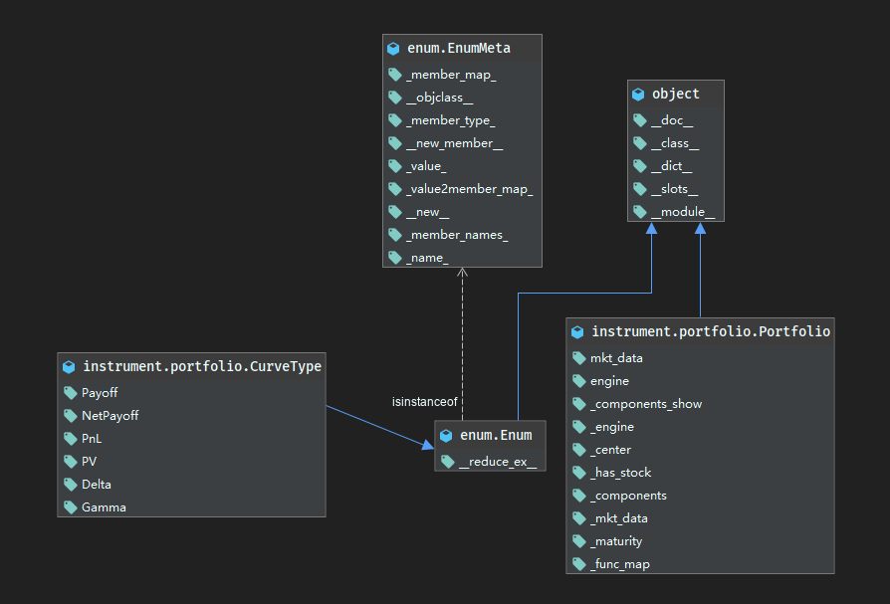
Data Structure
Portfolios

Slide 9
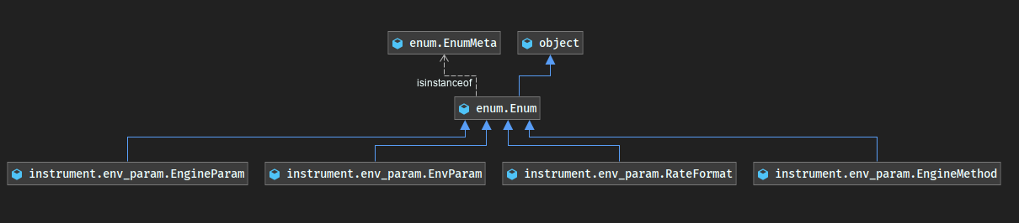
Environment
General setting for option pricing and option Greeks

Slide 10
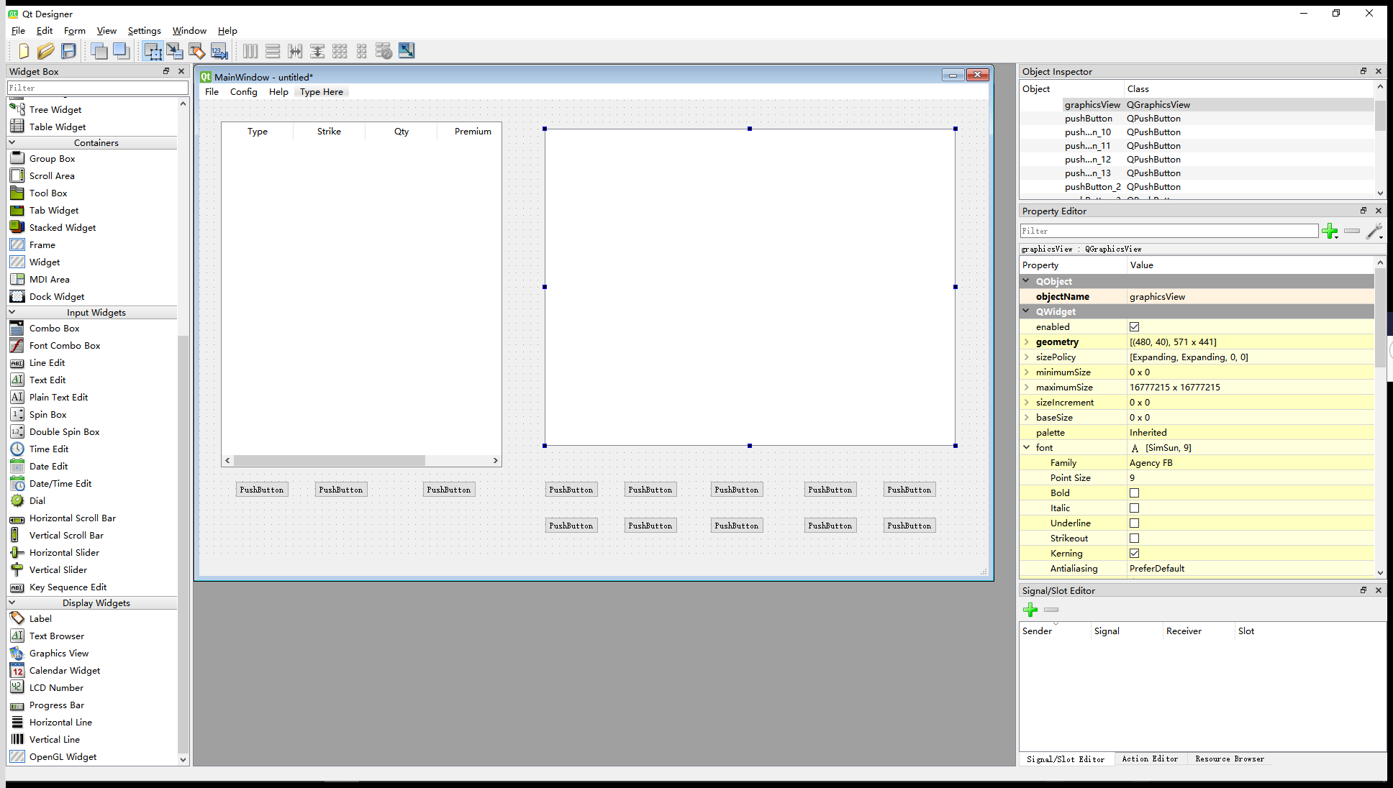
GUI
Based on PyQt 5.12.0
QtDesigner
+
QtUIC
+
QtRCC

Slide 11
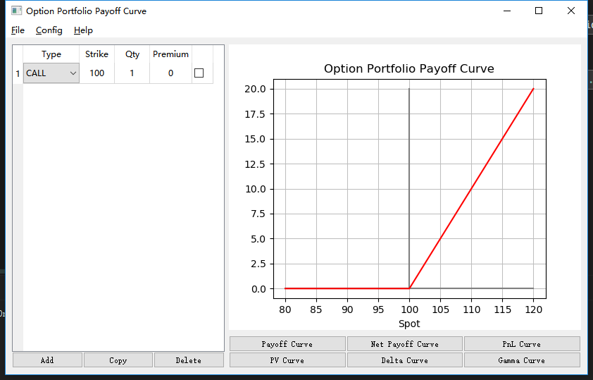
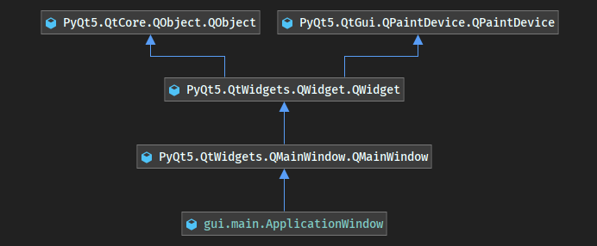
Main Window

Slide 12
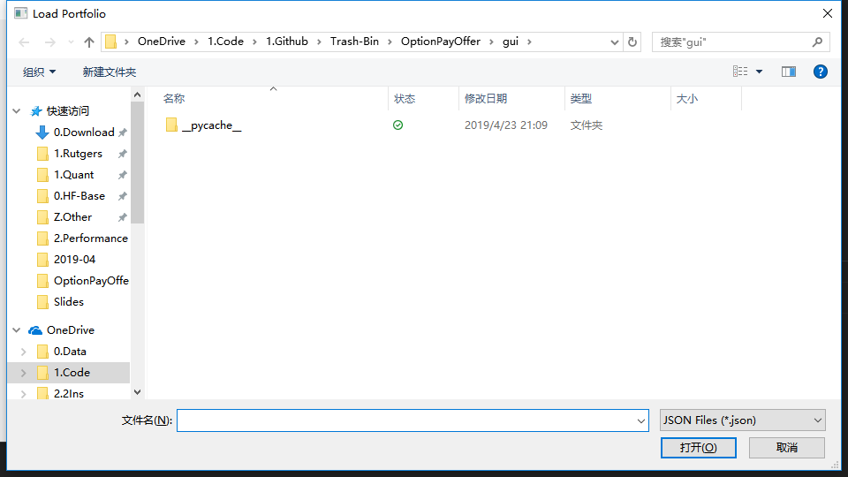
Load / Save / Export
PyQt5.QtWidgets.QFileDialog.getOpenFileName

Slide 13
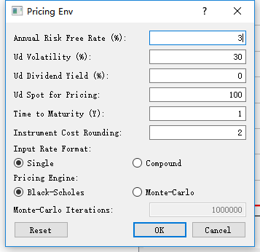
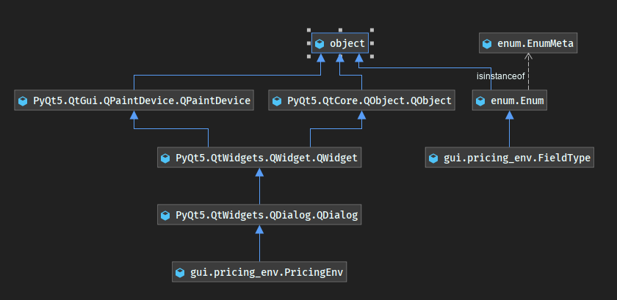
Setting Dialog

Slide 14
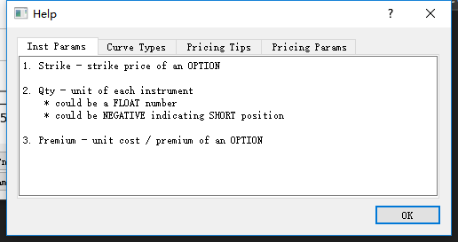
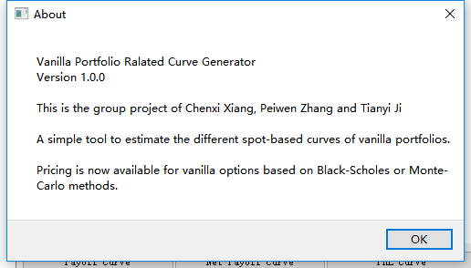
Help & About

Slide 15
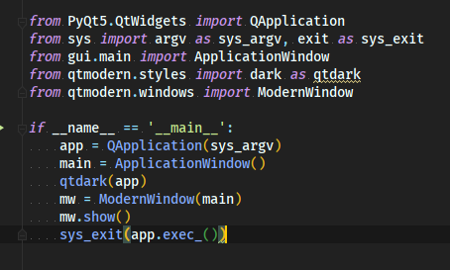
Style

Slide 16
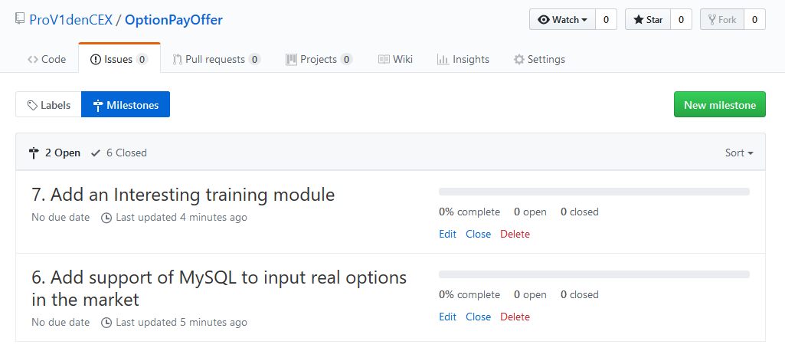
Backlog

Slide 17
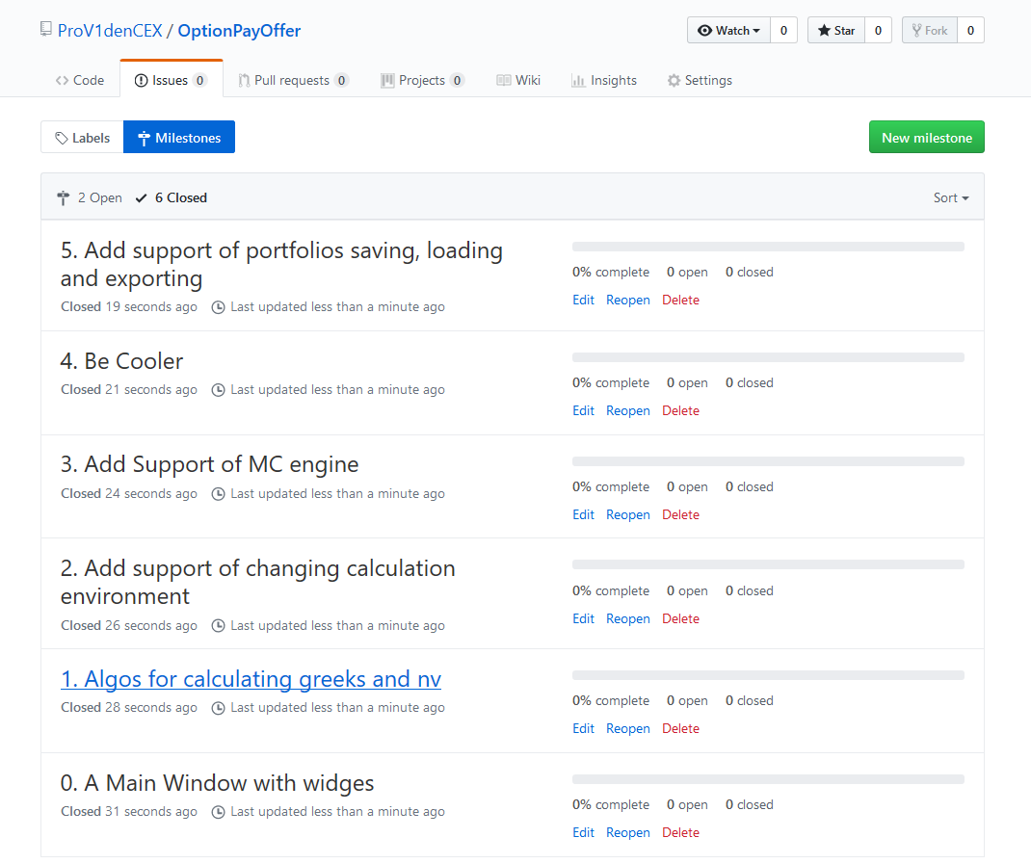
Milestones

Slide 18
OptionPayOffer
Thank you for your attention!
April 24 2019
Chenxi Xiang
186003830
Peiwen Zhang
174009097
Tianyi Ji
190003115

